Slide 1
Lecture 9
Interfacing I/O Device

Slide 2
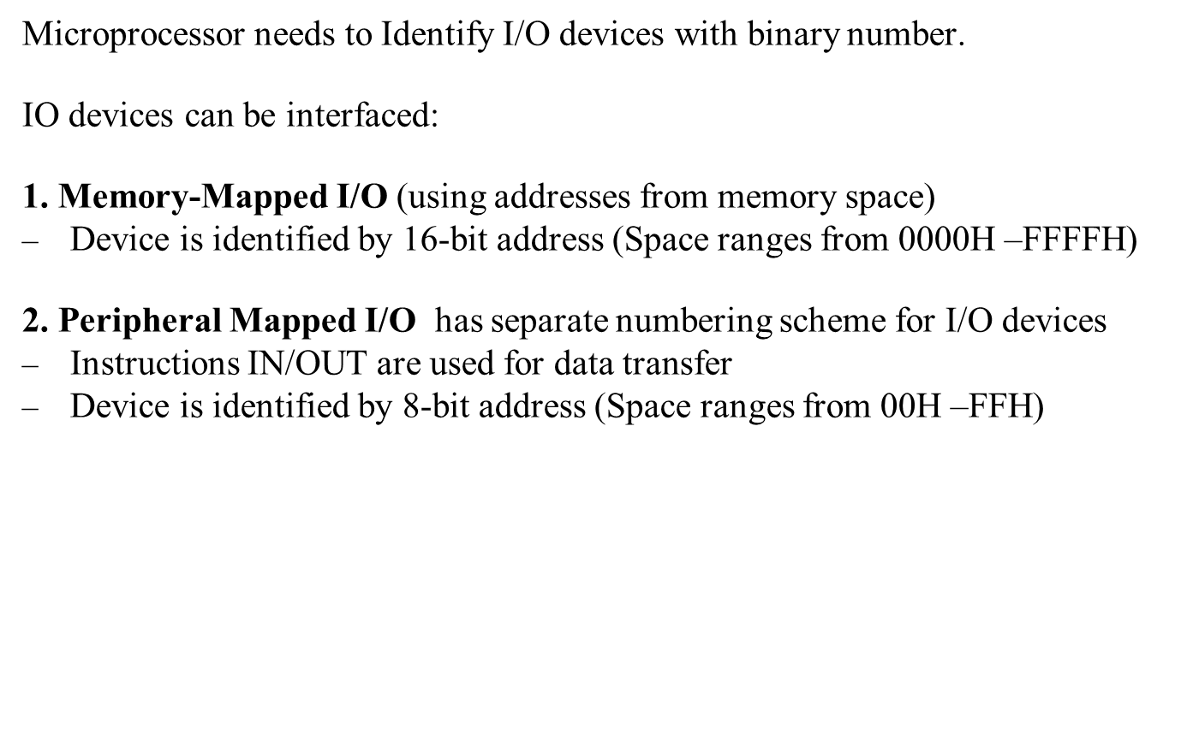
8085 interfacing with I/O Devices
*
Notes:
*

Slide 3
Memory Mapping Vs Peripheral I/O
Memory mapped I/O
In this device add is 16 bit ( A0-A15)
MEMR^ and MEWR^ control signals are used
Instructions are LDA add, STA Add, MOV A,M
Data trans. Bet reg and I/O devices
No. of I/O devices interface= 65536
( Theoretically)
I/O mapped I/P
In this device add is 8 bit (A0-A7)
IOR^ and IOW^ control signals are used
Instruction are IN Add, OUT Add
Data trans. Bet acc and I/O devices
No. of I/O devices interface= 256 only
*
Notes:
*

Slide 4
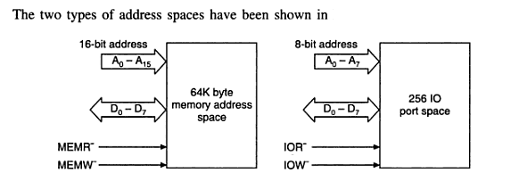

Slide 5
Peripheral I/O Instructions
Instruction IN (code DB) inputs data from an input device into accumulator.
Opcode Operand Description
IN 8-bit Port address 2-byte instruction with hexadecimal instruction DB and second byte is port
number of input device.
Memory Machine Code Mneumonics
Address
2065 DB IN 84
2066 84
Instruction OUT (code D3) sends the content of the accumulator to output device such as LED display.
Opcode Operand Description
OUT 8-bit Port address 2-byte instruction with hexadecimal instruction D3 and Second byte is port number of output device.
Memory Machine Code Mneumonics
Address
2050 D3 OUT 01
2051 01
*
Notes:
*

Slide 6
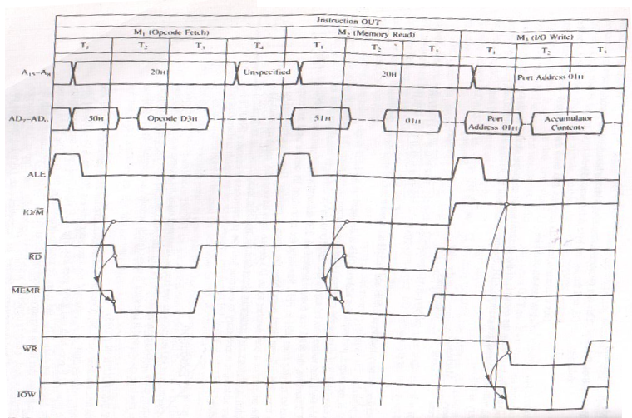
OUT Instruction
*
Notes:
*

Slide 7
OUT Instruction
In First Machine cycle M1(Opcode Fetch), microprocessor places the 16-bit memory address from the program counter (PC) on the address bus. At T1 20H is placed on A15-A8 and 50H is placed on AD7-AD0. ALE goes high, IO/M’ goes low indicates memory related operations. ALE indicates the availability of the address on AD7-AD0. At T2 microprocessor sends RD’ control signal which is combined with IO/M’ to generate MEMR’ signal and processor fetches the instruction code D3 using data bus.
M2 (memory Read), 8085 places next address 2051H on address bus and get device address 01H.
M3 (I/O write), 8085 place device address 01H on low and high address bus both.IO/M’ goes high to indicate I/O operation. At T2 AC contents are placed on data bus followed by control signal WR’. If we connect data bus to latch we can catch the information and display on LEDs and Printer. By ANDing IO/M’ and WR’ signals IOW’ signal enable output device.
Information necessary for interfacing output device is available during T2 and T3 of
the M3 cycle.
*
Notes:
*

Slide 8
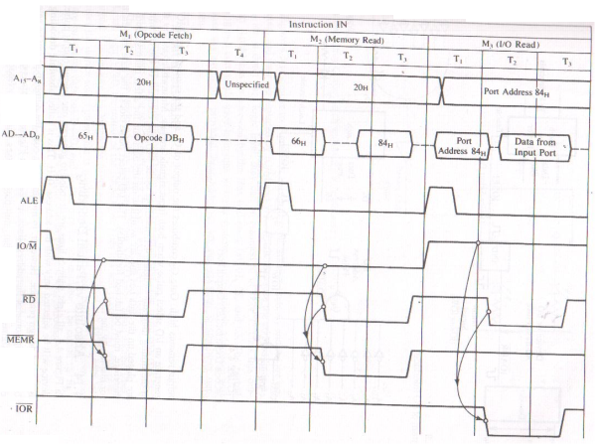
IN Instruction
*
Notes:
*

Slide 9
IN Instruction
In First Machine cycle M1 (Opcode Fetch), microprocessor places the 16-bit memory address from the program counter (PC) on the address bus. At T1 20H is placed on A15-A8 and 65H is placed on AD7-AD0. ALE goes high, IO/M’ goes low indicates memory related operations. ALE indicates the availability of the address on AD7-AD0. At T2 microprocessor sends RD’ control signal which is combined with IO/M’ to generate MEMR’ signal and processor fetches the instruction code DB using data bus.
M2 (Memory Read), 8085 places next address 2066H on address bus and get device address 84H.
M3 (Memory Read), 8085 place device address 84H on low and high address bus both and asserts RD’ signal. IO/M’ goes high to indicate IO operation. At T2 data from input port are paced on data bus and transferred to AC. By ANDing IO/M’ and WR’ signals IOR’ signal to enable input port.
RD
*
Notes:
*

Slide 10
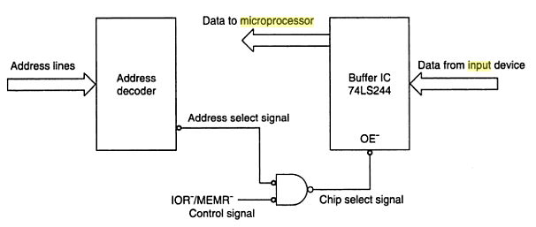
Input Interfacing
Notes:
*

Slide 11
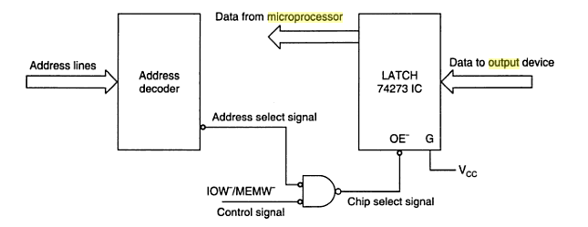
Output Interfacing
Notes:
*

Slide 12
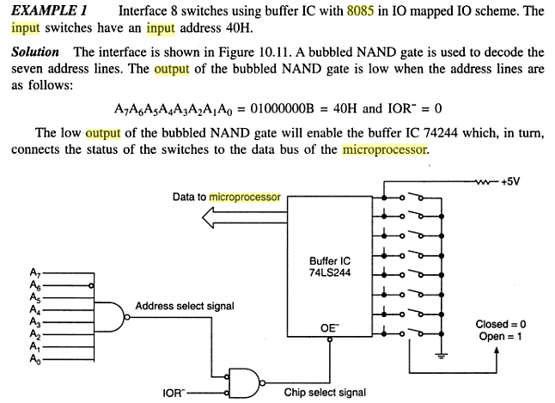

Slide 13
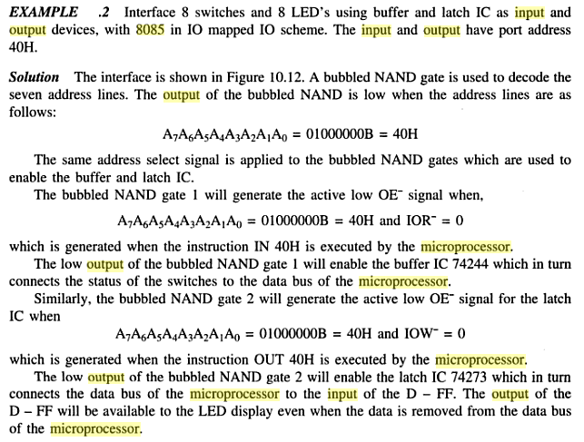

Slide 14
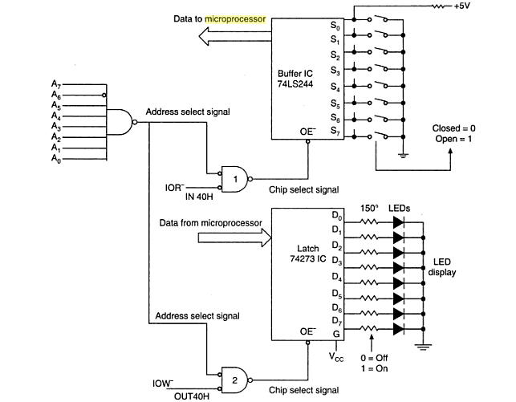

Slide 15
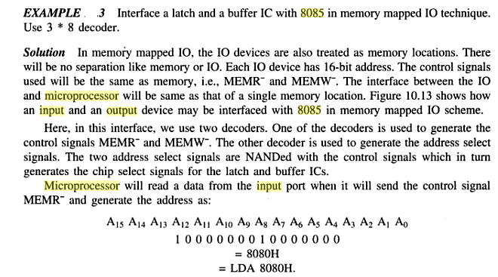

Slide 16
